Slide 1
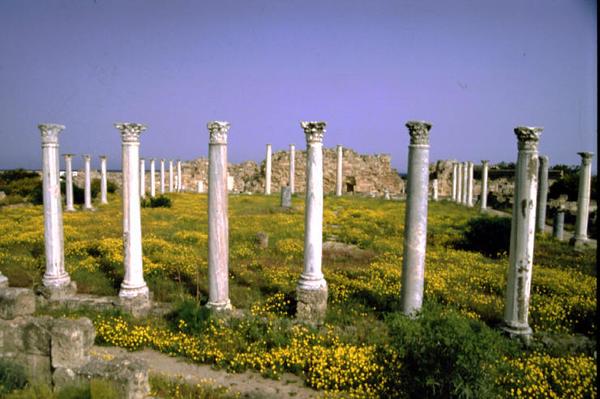
Corporate Culture Workshop

Slide 2
Corporate Culture Workshop
Purpose: deep analysis of your corporate culture to discover how it will interact with your adoption of OpenAgile.
Agenda:
Exercise: What is Culture?
Aspects of Culture
Cultural Artifacts
Espoused Values
Underlying Assumptions
Workshop: Your Corporate Culture
NOTE: this workshop normally takes four hours.

Slide 3
Corporate Culture Workshop
Exercise: What is Culture?
This is an exercise for the whole group:
Name some “cultures” (examples: Canadian, Punk Rock)
Discuss together: Why do we call these “cultures”?
What do you think Culture is?

Slide 4
Corporate Culture Workshop
What is Culture?
What linguists have said (Wikipedia, April 2007):
Generally refers to patterns of human activity and the symbolic structures that give such activity significance.
Anthropologists most commonly use the term "culture" to refer to the universal human capacity to classify, codify and communicate their experiences symbolically.
“It is the way people live in accordance to beliefs, language, history, or the way they dress."

Slide 5
Corporate Culture Workshop
Aspects of Culture
External Survival Issues: “Succeeding”
Mission, strategy and goals
Means: structure, systems, processes
Measurement: error-detection and correction
Internal Integration Issues: “Working Together”
Common language and concepts
Group boundaries and identity
The nature of authority and relationships
Allocation of rewards and status
“What We Believe:” Expressions of How We View...
The nature of reality and truth
The nature of humans and their relationships
The nature of time and space

Slide 6
Corporate Culture Workshop
Cultural Artifacts
ar·ti·fact or ar·te·fact /ˈɑrtəˌfækt/ , noun
1. any object made by human beings, esp. with a view to subsequent use.
2. a handmade object, as a tool..., characteristic of an earlier time or cultural stage, esp. such an object found at an archaeological excavation.
3. any mass-produced, usually inexpensive object reflecting contemporary society or popular culture: artifacts of the pop rock generation.
Dictionary.com Unabridged (v 1.1). Retrieved April 13, 2007

Slide 7
Corporate Culture Workshop
Cultural Artifacts
‘Cultural Artifacts’ are the things that we create in going about what we do. Things we see, hear and otherwise perceive in and around our work environment.
Example #1: Constant meetings, informal dress, no closed doors, noisy, prominently displayed employee-of-the-month awards, mascot animals, company “jargon”
Example #2: Strongly personalized work spaces, quiet heads-down work, impersonal front-desk security, empty games room, quotes from famous people
Caution: artifacts are a symptom...
the reasons for them are unknown without further investigation

Slide 8
Corporate Culture Workshop
Espoused Values
Espoused Values are the accepted, explicit reasons for the way things are done
Published, publicly announced or oft quoted values
An organization may have a document that describes the values, principles, ethics and vision
  E.g. Integrity, Teamwork, Customer Satisfaction, Quality
We might notice inconsistencies between espoused values and the related cultural artifacts
  These reveal opportunities to look at the deeper assumptions driving that culture

Slide 9
Corporate Culture Workshop
Underlying Assumptions
Conflicts between espoused values and cultural artifacts
expose underlying tacit (unvoiced or unspoken) assumptions.
What really drives organizational culture?
Cultural Artifacts
Espoused Values
Tacit, Shared Assumptions

Slide 10
Corporate Culture Workshop
Underlying Assumptions
Organizational behavior is often driven by underlying values, beliefs and assumptions of the founders and leaders...
...usually because those assumptions led to success in the past
Therefore, look to the organization's history to find out what is believed to have made it successful
  Founder's personality
  Major crises
  Major successes
Also look for behavior that is not in line with espoused values or behavior that changes based on context

Slide 11
Corporate Culture Workshop
Workshop: Your Corporate Culture
You are going to look at the culture of your organization,
its Values, Artifacts and Assumptions.
This exercise is inspired by Edgar H. Schein's “Corporate Culture Survival Guide.”
Purpose:
Due to the substantial impact and influence of OpenAgile adoption on culture and culture on OpenAgile adoption...
Having looked deeply at OpenAgile...
Now we look deeply at your corporate culture...
So that we can find what helps and what hinders your implementation of OpenAgile
This is a sort of Retrospective, so we should review the
“Retrospective Prime Directive” www.retrospectives.com

Slide 12
Corporate Culture Workshop
Workshop: Your Corporate Culture
Regardless of what we discover, we understand and truly believe that everyone did the best job they could, given what they knew at the time, their skills and abilities, the resources available, and the situation at hand.
-Retrospective Prime Directive

Slide 13
Corporate Culture Workshop
Workshop: Your Corporate Culture
Work in groups of 5 or 6, spend ½ hour on:
Create List 1: “Our corporate cultural artifacts”
  Do a mental walk-through of your space, your day and your year – what do you notice? Be specific!
  Ask the newer people in your group what they noticed when they first arrived.
  Ask the veterans of your organization what they have noticed as recent changes.
  What isn't visible?
Now walk around and review all the other groups' lists.

Slide 14
Corporate Culture Workshop
Workshop: Your Corporate Culture
Continue in your groups, spend ½ hour on:
Create List 2: “Our corporate espoused values”
  Look for guidelines, vision statements, rules, handbooks
  Write these things down!!!
  What isn't stated?
Now walk around and review all the other groups' lists.

Slide 15
Corporate Culture Workshop
Workshop: Your Corporate Culture
Continue in your groups, spend ½ hour on:
Create List 3: What are the corporate underlying assumptions?
“At <organization name>, we believe _________________”
  Compare List 1 and List 2... are there inconsistencies?
  Look for unspoken rules/assumptions that are also part of your culture (“just the way things are around here” - no real explanation...)
  Consider the company's history, founder's beliefs, successes, failures
  Also consider why you stay, or why you are thinking of leaving!
Example:
At BigBureaucratic Corp, we believe that competition among individuals is more effective than teamwork.
  espoused value of teamwork, but individual reviews and ranking
Now walk around and review all the other groups' lists.

Slide 16
Corporate Culture Workshop
Workshop: Your Corporate Culture
What we have discussed today is sure to influence your thinking. Let's look forward together for a moment:
Examine the lists so far and decide: how do these artifacts, values and assumptions affect your adoption of OpenAgile?
  Mark what helps with , what hinders with 
  Not all items will be applicable one way or the other

Slide 17
Corporate Culture Workshop
Workshop: Your Corporate Culture
What we have discussed today is sure to influence your thinking. Let's look forward together for a moment:
Which hindering items can you realistically address and change first? Create List 4 “OpenAgile Improvement Backlog” by choosing 2 or 3 items and discuss how you will address these items.
Choose items that are Important, Possible and Interesting

Slide 18
Corporate Culture Workshop
Workshop: Your Corporate Culture
What to do next?
Find a common place to display the obstacles and their action items
Make a commitment to work on them (group, not individual!)
Those who agree to work on these action items meet again (no more than 4 weeks); run your improvement efforts as a OpenAgile team!

